Slide 1
POD ORION SQL Capstone project

Slide 2
glossary
MALIGNANT (CANCEROUS) LESIONS:
BCC – Basal Cell Carcinoma,
SCC – Squamous Cell Carcinoma,
MEL – Melanoma
BENIGN (NON-CANCEROUS) LESIONS:
NEV – Nevus (Mole),
SEK – Seborrheic Keratosis
PRECANCEROUS:
ACK – Actinic Keratosis (Not cancer yet, but can become malignant)

Slide 3
Risk Factors: Demographics & Environment
DRINKING & SMOKING HABITS:
Users: 100% developed lesions (approx. 71% cancerous).
Non-Users: Higher overall volume of lesions but comprised mostly of non-cancerous/ACK (75.5%).
ANCESTRY & AGE:
High Risk Roots: German, Pomeranian, and Italian ancestries show high history of skin cancer and ACK.
Age: Elderly predominantly present cancerous lesions.
Younger demographics show benign (NEV) lesions

Slide 4

Risk Factors: Demographics & Environment
PESTICIDE EXPOSURE:
Exposed: Primarily develop cancerous lesions and ACK (pre-cancerous).
Unexposed: Lower risk profile (32% non-cancerous, 46% ACK, 22% cancerous).
GENDER DIFFERENCES:
Females: Higher rate of confirmed cancer (43.4%) vs. males (26%).
Males: Higher rate of ACK/pre-cancerous lesions (45%).
INFRASTRUCTURE (WATER/SEWAGE):
With Piped Systems: Surprisingly, higher risk (61.8% cancerous).
Without Systems: Lower malignancy (18.42% cancerous, 47.86% ACK).

Slide 5
Lesion Characteristics & Symptoms
SKIN TYPE CORRELATION:
Type 0: Exclusively benign.
Type 1, 2, 3, 4 & 5: Mostly malignant and mixed presentation.
Type 6: Exclusively benign (However, sample size was insufficient to be certain)
BODY REGION DISTRIBUTION:
High Malignancy Risk: Arm, Forearm.
High Benign Frequency: Abdomen, Foot, Hand, Scalp, Thigh.
Mixed Presentation: Face, Back, Chest, Neck, Ear, Nose, Lip

Slide 6
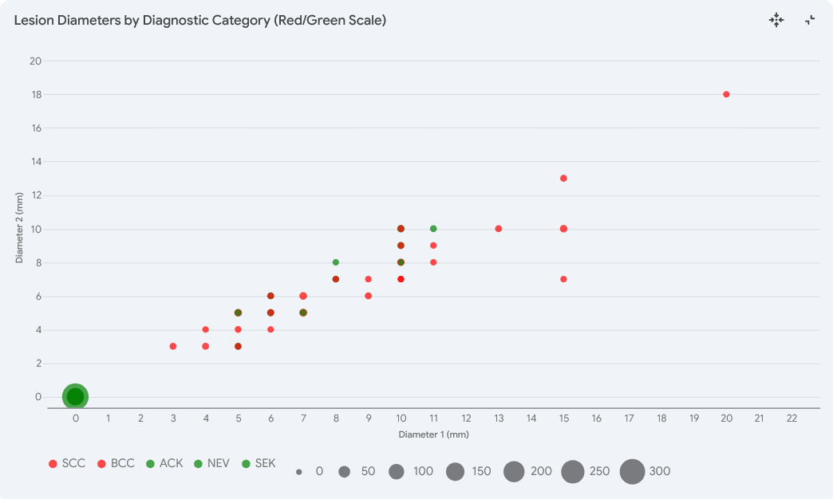
Lesion Characteristics & Symptoms
Diameter:
Data indicates that overall, noncancerous lesions have smaller diameters than cancerous lesions which can grow to as much as 18 – 20mm in diameter.
Noncancerous are typically 0mm in diameter with abnormality showing a max size of 10 – 11 mm.
Cancerous lesions are typically anywhere from 3 – 20mm

Slide 7
Lesion Characteristics & Symptoms
SYMPTOMATIC INDICATORS:
Cancerous Lesions: High correlation with itching, growth, pain, bleeding, and elevation.
Non-Cancerous: Including ACK lesions,
reported significantly fewer symptoms as itching, growth, pain, bleeding, and elevation.

Slide 8
THANK YOU

